Slide 1
ESTATE PLANNING BASICS WORKSHOP
PRESENTED BY: SARA BACHMAN OF BACHMAN LAW, LLC
HOSTED BY: THE WEST END PAY IT FORWARD TRUST & THE LONE CONE LEGACY TRUST
Lone Cone Legacy Trust

Slide 2
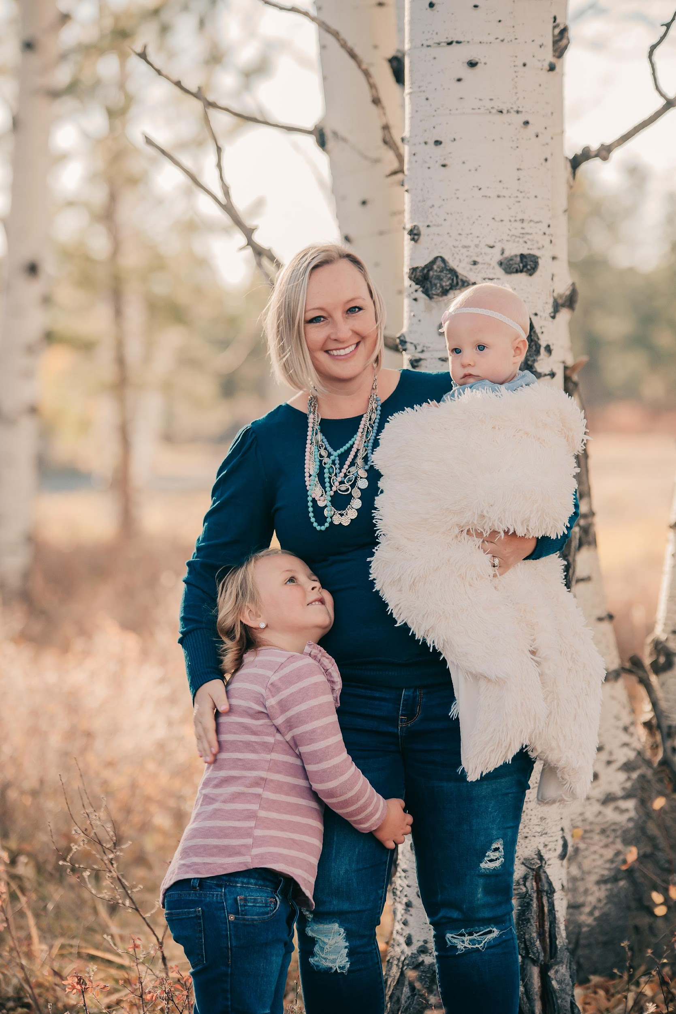
ABOUT YOUR PRESENTER

Slide 3
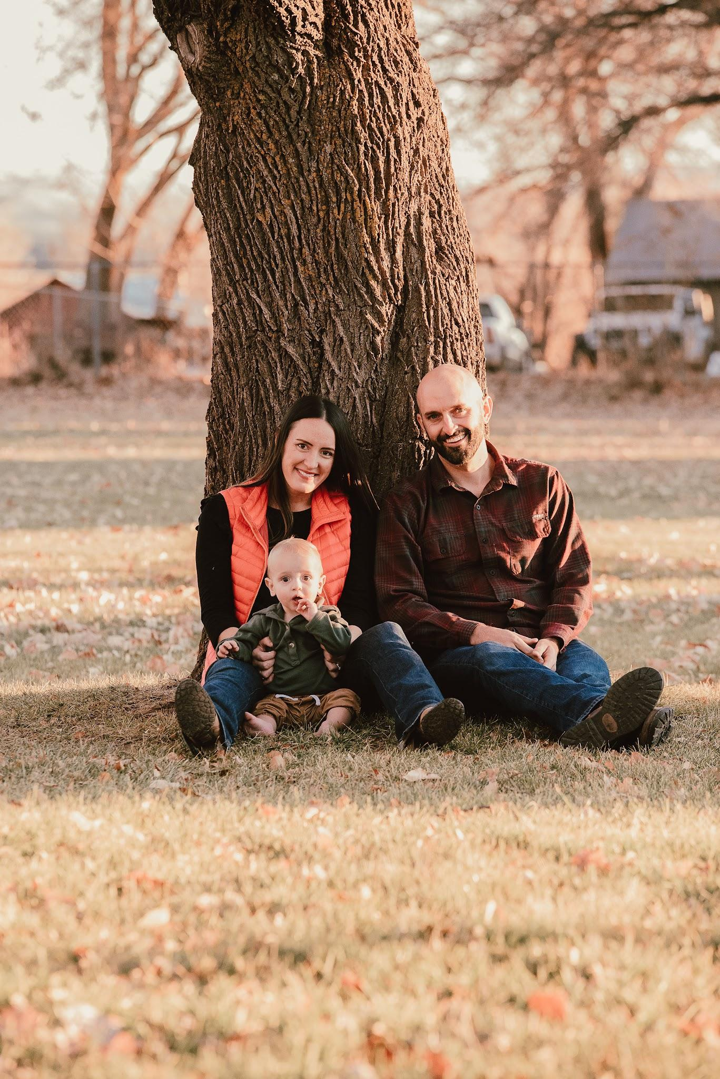
WITH GUEST SPEAKER KENDRA BALLARD
Insert picture

Slide 4
PRESENTATION OUTLINE & RULES FOR THE EVENING
OUTLINE
Wills
Powers of Attorney
Charitable Giving
There is not a one-size fits all approach to Estate Planning; this presentation is meant to bring light to important estate planning topics but is oversimplified for time purposes.
Quasi In-Person & Zoom Event
Feel free to raise hand and ask questions.

Slide 5
WHAT IS A WILL & WHY DO I NEED ONE?
LAST WILL & TESTAMENT
Not to be confused with a Living Will
A written document that sets forth your wishes as to:
Who distributes your probate estate?
Personal Representative/Executor
Who is entitled to your assets?
Equally important = who is not
How are your assets distributed?
Outright or in Trust
Nominates guardian of your disabled or minor children.
MYTH: HAVING A WILL MEANS NO PROBATE.

Slide 6
LAST WILL & TESTAMENT
CRS § 15-10-201(59)
FORMS OF WILLS
“Will” includes any codicil and any testamentary instrument that merely appoints an executor, revokes or revises another will, nominates a guardian, or expressly excludes or limits the right of an individual or class to succeed to property of the decedent passing by intestate succession.
Formal Will
Prepared by a professional or a typed form with self-proving attestations
Informal Will
Writing intended to be a Will
Handwritten-holographic Will

Slide 7
WILLS ONLY APPLY TO PROBATE ESTATE
IMPORTANT!
Probate estate is everything in your sole name at your death.
Not included in probate estate:
Assets held in joint tenancy
Assets that pass to a survivor by means of a Beneficiary or Transfer on Death Designation
OFTEN: PLAN A = JT/TOD & PLAN B = WILL

Slide 8
WHAT HAPPENS IF THERE IS NO WILL?
Everything defaults to the State’s rules.
Order of priority for Personal Representative Appointment.
Default beneficiary status.
Sometimes the State’s rules are exactly what you would have picked anyway.

Slide 9
WHAT IS PROBATE?
A process that appoints a person in charge of a decedent’s estate and who the beneficiaries of the estate are.
Process differs in every state.
Free instruction forms: JDF 906 & 907
https://www.courts.state.co.us/Forms/

Slide 10
2022 ESTATE & GIFT TAX INFORMATION
Federal Estate & Gift Tax Exemption = $12.06 million/person
Colorado Estate & Gift Tax = $0
Annual Gift Tax Exemption = $16,000/person

Slide 11
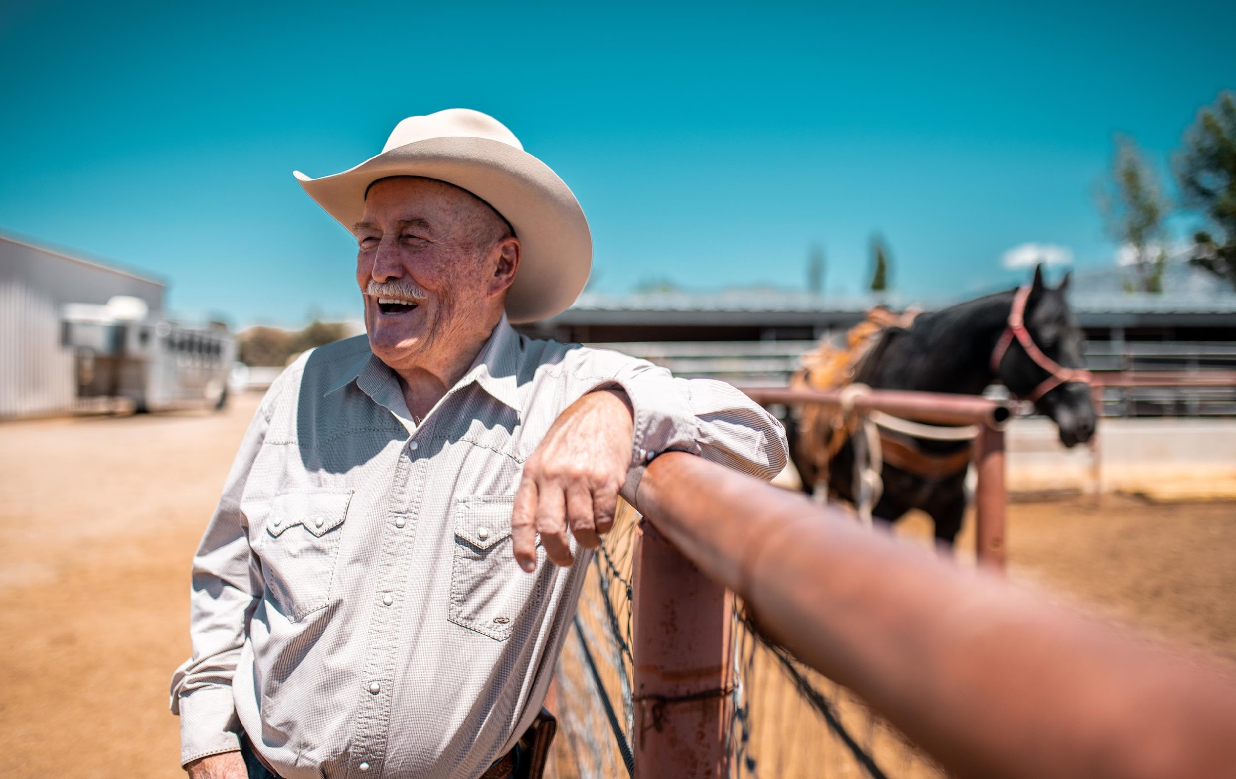
DURABLE FINANCIAL POWER OF ATTORNEYS
Durable Financial Power of Attorney
Appoints someone to take care of all aspects of your life except your body.
Only works while you are alive.
Usually “alive” upon signing.
May circumvent need for a court-appointed conservator.
Most abused document on behalf of elders.
Durability

Slide 12
DURABLE MEDICAL POWERS OF ATTORNEY & LIVING WILLS
Durable Medical Power of Attorney
Appoints someone to make health care decisions for you if you cannot.
Your agent can be your health care advocate or put your final wishes in action
Should be durable.
Living Wills aka Advance Directives
Organ Donation Directives
DNRs Executed with your Doctor

Slide 13
PLANNING IS A GIFT TO YOUR LOVED ONES
IF YOU DON’T WANT TO BE A BURDEN TO YOUR LOVED ONES, GIVE THEM THE TOOLS TO HELP YOU DURING LIFE & AFTER DEATH

Slide 14
CHARITABLE GIVING
What is a charitable gift?
Contribution of cash or property to a QUALIFIED charity
Section 501(c)(3) organizations are eligible to receive TAX DEDUCTIBLE contributions
What kinds of contributions aren’t deductible
Contributions to a specific person, contributions to a nonqualified organization, the value of your time or services, your personal expenses, any part of your contribution from which you receive or expect to receive a benefit
Charitable Deductions
Amount you can deduct is limited to a specific % of your AGI
Deductions limited to 60%, 50%, 30%, and sometimes 20% of AGI depends on the type of Organization you’re gifting to and the type of gift (outright vs. gift in trust vs. capital gain property)
There are many ways to give to charity during life and at death
During life
Outright gifts, Charitable Trusts, Donor Advised Funds, and Charitable Contributions from IRAs (QCDs)
At death
Will or Trust bequests
Beneficiary Designations
Charitable Trusts

Slide 15
IF YOU ENJOYED THIS PRESENTATION, PLEASE CONSIDER A ONE-TIME OR REOCCURRING GIFT TO YOUR AREA TRUST
You may donate in number of ways:
RIGHT NOW, IN PERSON!
WEST END PAY IT FORWARD TRUST
Mail: PO Box 171, Naturita, CO 81422
Online: https://www.westendpayitforward.org/donate
LONE CONE LEGACY TRUST
Mail: PO Box 565, Norwood, CO 81423
Online: https://loneconelegacy.org/

Slide 16
